Slide 1



What IS Social Psychology and How Do We Study It?

Slide 2

Introduction
Definition
Core Themes and Core Concerns of Social Psychology
Key Theoretical Perspectives
How Social Psychologists DO Social Psychology

Slide 3

What IS Social Psychology?
Sociology
Psychology

Slide 4

Definition
Social Psychology Bridges the Interests of Psychology (emphasis on the Individual) and Sociology (emphasis on Social Structure)
“the systematic study of the nature and causes of human social behaviour.”
Interested in WHAT People Do and WHY They Do It

Slide 5
Key Themes
We Construct Our Social Reality
Social Influences
Social Relations
Application of Knowledge

Slide 6
Core Concerns
The Impact One Individual has on Another
The Impact that a Group has on its Individual Members
The Impact that Individual Members have on the Groups they Belong to
The Impact that One Group has on Another Group
The Impact of Social Context and Social Structure on Groups and Individuals

Slide 7
The Impact One Individual has on Another
People Make a Great Impact on Each Other
Direct and Explicit
Indirect and Implicit

Slide 8
The Impact that a Group has on its Individual Members
Establishment of Rules and Norms
Norms are the informal rules that govern our behaviour

Slide 9



The Impact that Individual Members have on the Groups they Belong to
Impact Goes Both Ways

Slide 10
The Impact that One Group has on Another Group
Groups Impact Groups
Area of Research - Intergroup Conflict

Slide 11
The Impact of Social Context and Social Structure on Groups and Individuals
Individual
Society

Slide 12
Theoretical Perspectives
Symbolic Interactionism
Group Processes
Social Structure and Personality
Cognitive Perspectives
Evolutionary Theory

Slide 13
1. Symbolic Interactionism
Developed by Charles Horton Cooley and George Herbert Mead
“Symbolic Interactionism” was Coined by Herbert Blumer
SI theorists understand the world as the product of the everyday interactions of people

Slide 14
SI - Blumer’s SI Premises
People Act Towards Things Based on the Meaning Those Things Have for Them
These Meanings are Derived Through Social Interaction and are NOT Inherent
Meanings can be Modified and Changed Through Social Interaction

Slide 15
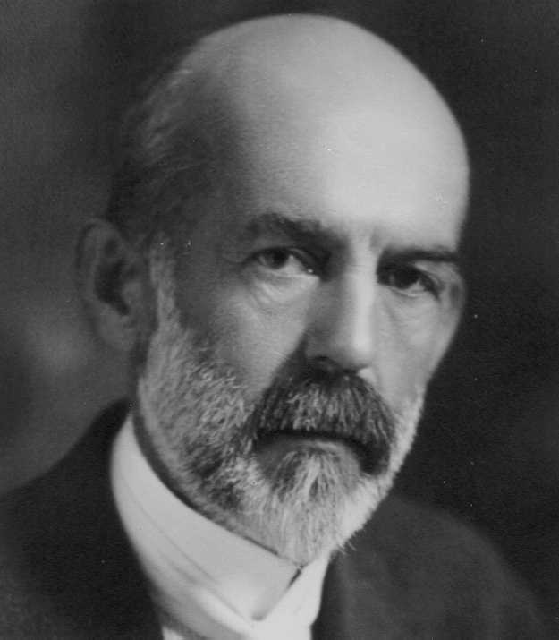
SI - Looking-Glass Self
Three Elements
Imagine how we appear to others
Imagine the other person’s reaction to our appearance
Respond with some sort of feeling
Shame, Pride, Guilt, Happiness

Slide 16
2. Group Processes
The ‘Group’ as a Social Psychological Entity
What is a Group?
Two or More People
Become an ‘Us’
Dependence on One Another
Rules, Roles, Norms, Power Structures

Slide 17
Social Exchange Theory
Social Exchange
Cost-Benefit Ideology
Subjective

Slide 18
3. Social Structure and Personality
Social Structure
The Individual

Slide 19
Social Structure and Personality
What are Social Structures?
Relationships between groups of individuals
Ex. Social Class, Religion, Family, School, Mass Media, etc…

Slide 20
4. Cognitive Perspectives
Emphasis placed on mental activities as determinants of social behaviour
Problem Solving, Perception, Judgement, Memory
Cognitive Processes are an Intervening Factor Between External Stimuli and Behavioural Responses

Slide 21
Cognitive Concepts
Cognitions
‘mental processes of acquiring knowledge and understanding through thought, experience, and the senses’
Cognitive Structure
Cognitions as interrelated
Emphasis on how they are structured and the affect on behaviour and judgement
Schemas
A Blueprint of people and things

Slide 22


Schema Examples

Slide 23
5. Evolutionary Theory
Darwin’s Theory of Evolution
Social Behaviour is Linked to our Genes

Slide 24

How Social Psychologists DO Research

Slide 25
Empirical Research
“the systematic investigation of observable phenomena (behaviour, events) in the world.” (Delamater et al.)
Relies on Observable and Measurable phenomena

Slide 26
Research Methods in Social Psychology
Surveys
Field Studies
Content Analysis
Experiments

Slide 27
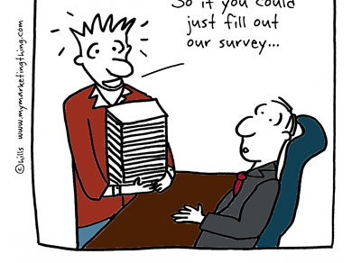
Surveys
Popular Source of Data Collection
Set of Questions Geared Toward Collecting Information about a Certain Group
Relies on Self-Reporting

Slide 28
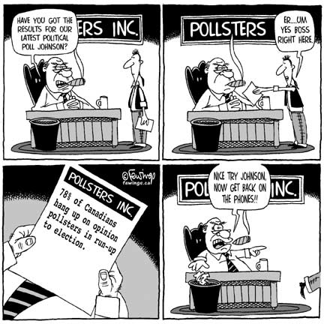
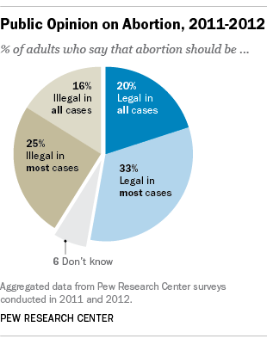
Example: Public Opinion Polls

Slide 29
Strengths and Weaknesses
Strengths:
Generally inexpensive
Potential clear picture of the phenomena under study
Glimpse into infrequent or private behaviours
Weaknesses
Problems with self-reporting

Slide 30

Field Studies
Observation of everyday life in action
Unobtrusive Measures
Participant Observation

Slide 31

Ethnography
Study of Medical Students
Understanding Latent Culture
Moving Beyond Technical Knowledge

Slide 32
Strengths and Weaknesses
Strengths
Real-World Behaviour
Study Private and Sensitive Matters (Unobtrusive)
In-Depth Understandings
Weaknesses
Significant Effect of Data Recording Method Chosen
The Issue of Consent
Time Consuming

Slide 33

Archival Research
The analysis of data that has already been collected by others
Sources of Archival Data
Government
Universities
Formal Organizations

Slide 34

Content Analysis
The systematic study of documents to identify themes and make inferences based on these themes

Slide 35

Example: Criminalization of HIV Non-Disclosure
Speakman (2017) “Constructing an ‘HIV-Killer: HIV Non-Disclosure and the Techniques of Vilification”
Content Analysis of:
Legal Documents
Newspaper Articles
On-Line Discussions

Slide 36
Strengths and Weaknesses
Strengths
Inexpensive
Less Time Consuming
Socio-Historical Analyses
Weaknesses
Level of Control over Quality of Information
Difficulty Creating a Reliable and Valid Study
Inconsistent or Missing Information in Archives

Slide 37
Experiments
High Level of Control
They are composed of 2 characteristics:
Independent Variables must be Manipulated
Participants must be Assigned Randomly

Slide 38
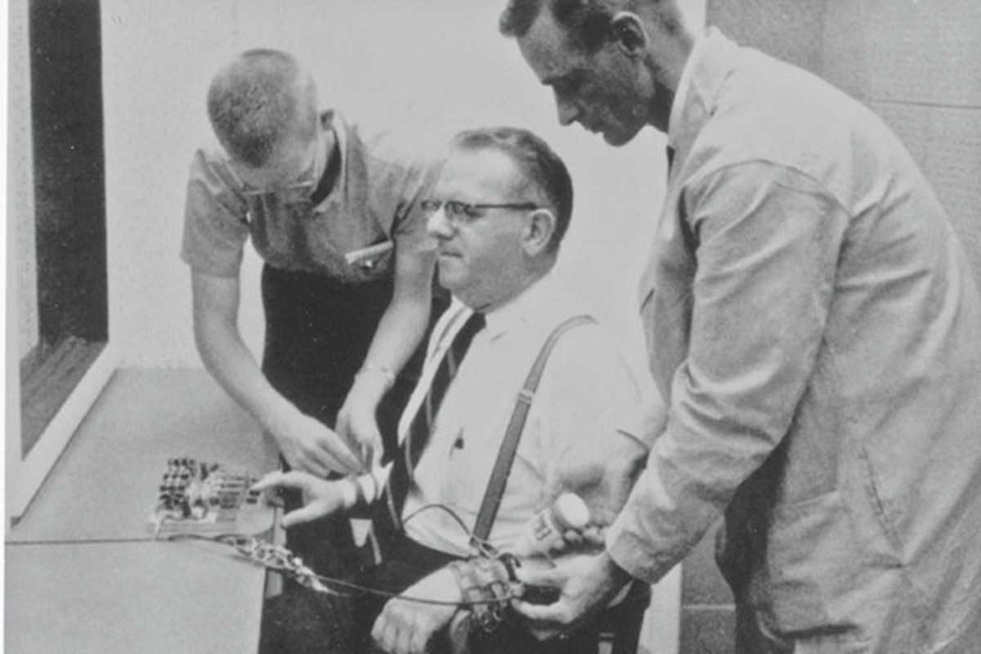
Lab Experiment
Researchers Have More Control
Can control the physical space

Slide 39
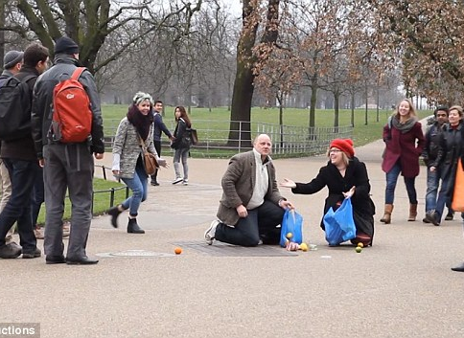
Field Experiment
Less Control
More Generalizable
Mitigation of Reactivity

Slide 40
Strengths and Weaknesses
Strengths
High level of internal validity
More researcher control
Weaknesses
Limits to what can be studied
Ethical concerns
Costly
Subject Effects and Experimenter Effects
Low External Validity

Slide 41
Ethics
Protecting and Respecting Research Participants
Ethics Approval is Required for Any Research Involving Human Subjects
The Role of The Nuremberg Trials in Modern Day Ethics

Slide 42
Protecting our Participants
Volunteer
Informed Consent
Avoiding Harm
Ensuring Confidentiality

Slide 43
Sources of Harm
Physical
Psychological
Breach of Confidentiality

Slide 44
The Stanford Prison Experiment
“How we went about testing these questions and what we found may astound you. Our planned two-week investigation into the psychology of prison life had to be ended after only six days because of what the situation was doing to the college students who participated. In only a few days, our guards became sadistic and our prisoners became depressed and showed signs of extreme stress."
Professor Zimbardo

Slide 45
The Stanford Prison Experiment
1971
Zimbardo - Lead Psychologist
Randomly Assigned Male College Students to the Roles of ‘Prison Guard’ and ‘Prisoner’
A Number of Ethical Issues
Violation of the harm principle, first and foremost

Slide 46


Have a Great Day!

